Slide 1
CLIP similarity-based Multimodal RAG verification method
Eun Oh Kim, Chang Geun Lee, Soo Yeon Yoon*
N2solution Co.,Ltd, *Kookmin University
Feb 07. 2025
*Corresponding author
Notes:
안녕하세요. CLIP 유사도 기반 멀티모달 RAG 기법에 대해 발표하게된 엔투솔루션 김은오입니다.

Slide 2
Instruction
Research Background
Research Questions
Improvement Measures
Conclusions
Notes:
발표는 다음과 같은 순서로 진행하겠습니다.

Slide 3
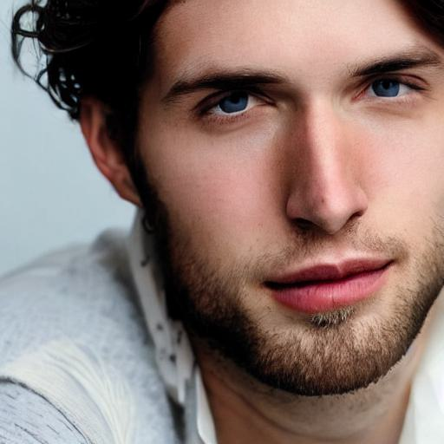
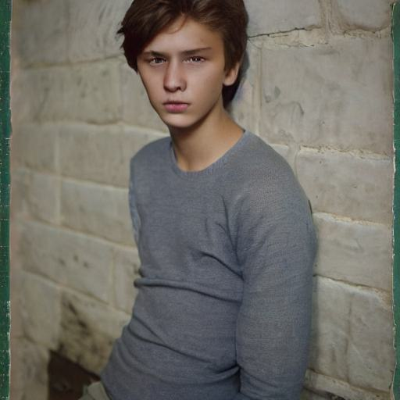
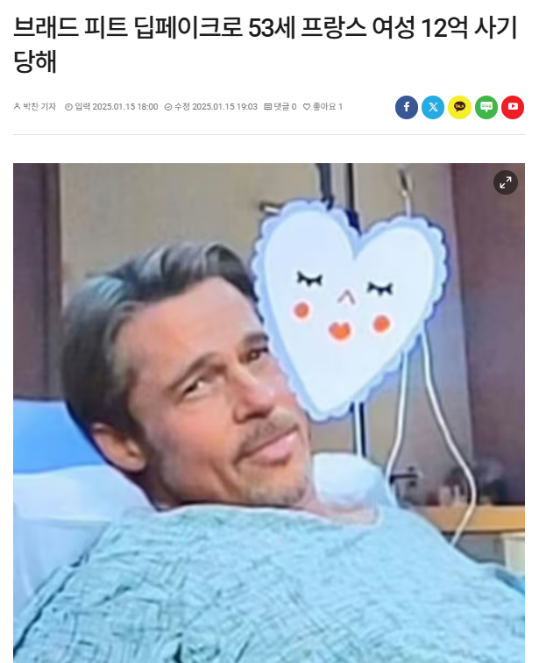
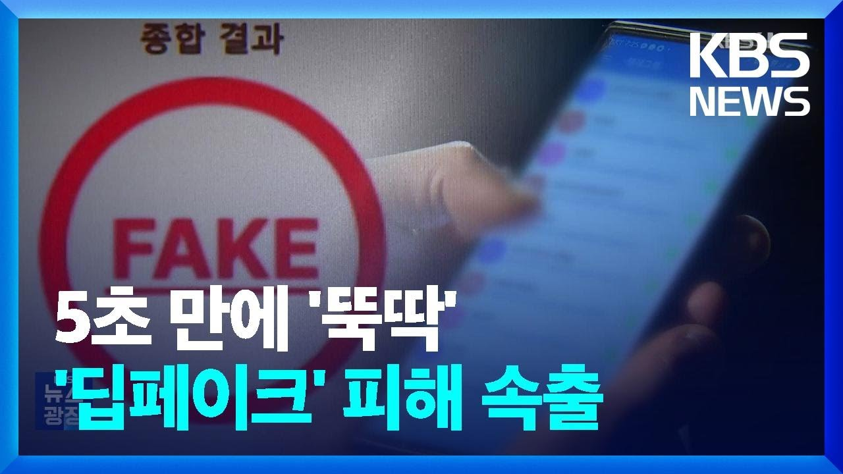
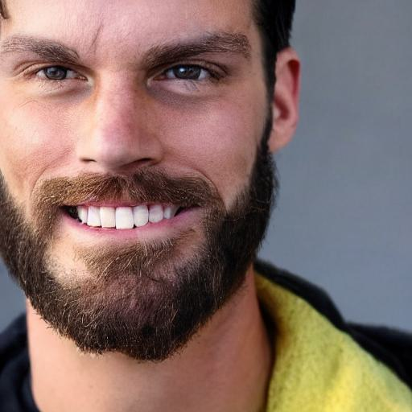
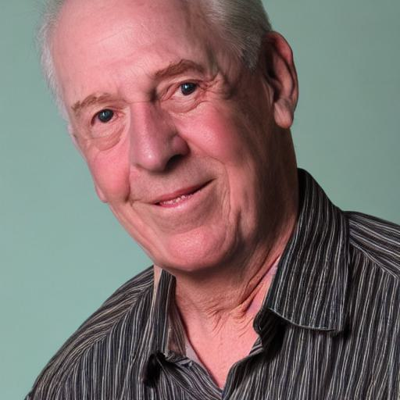
Introduction
Rising Threat of Deepfake Content
Rapid Proliferation of AI-Generated Manipulated Media
Deepfake Face image
Deepfake Abuse Cases (1)
Deepfake Abuse Cases (2)
Notes:
딥페이크 기술은 인공지능의 발전으로 인해 더욱 정교해지고 있습니다. 이에 따라 영상, 이미지, 오디오 등 다양한 멀티모달 데이터를 기반으로 한 조작 콘텐츠가 손쉽게 유포되고 있으며, 이는 신뢰성이 필수적인 뉴스, 보안 인증, 법적 증거물 등에 심각한 위협을 초래하고 있습니다.

Slide 4
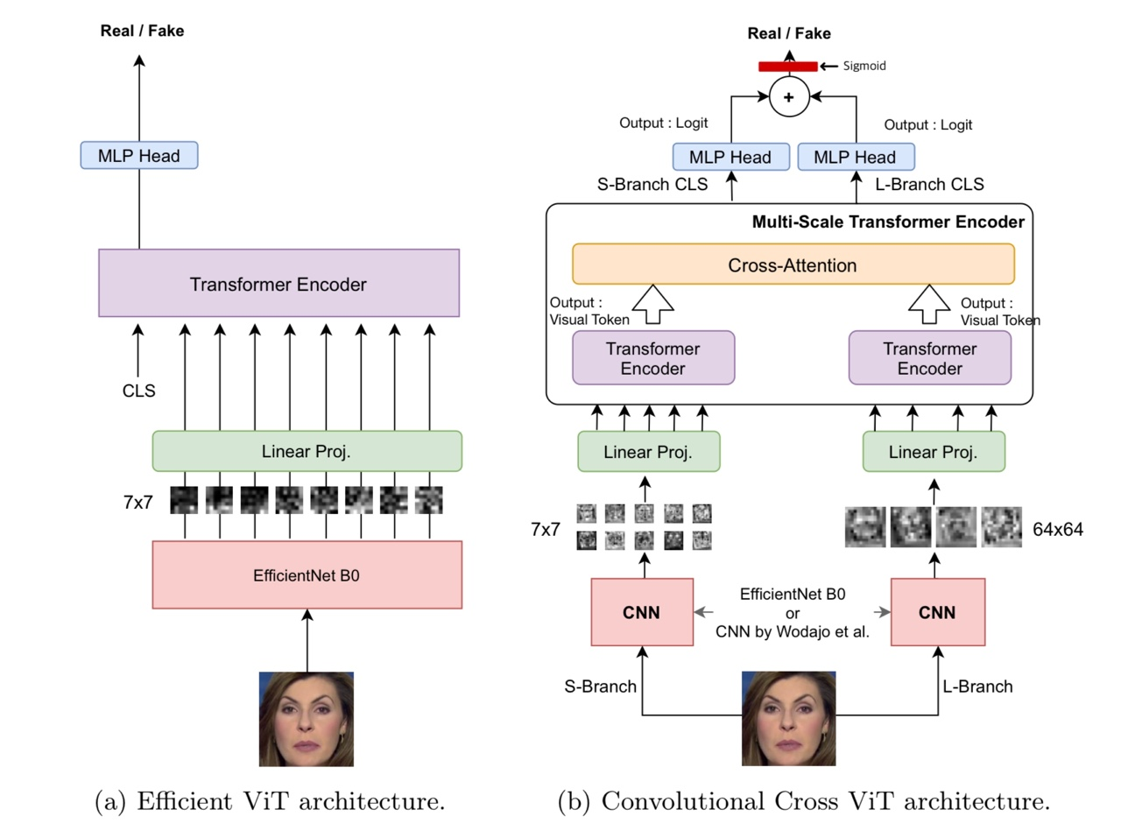
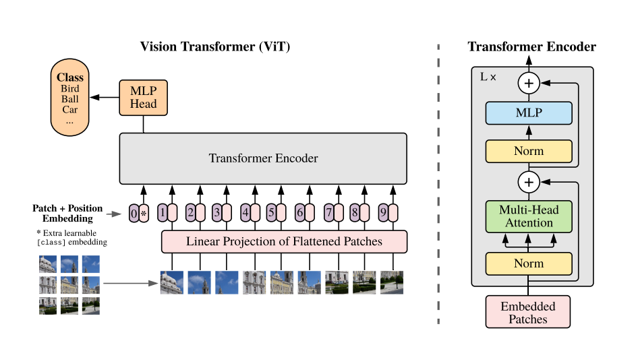
Research Background
Traditional Machine Learning and Deep Learning-Based Detection Requires Complex Configuration and Advanced Expertise.
Notes:
기존 딥페이크 탐지 기법은 머신러닝 및 딥러닝 모델을 중심으로 발전해왔으나, 새롭게 등장하는 합성·위조 콘텐츠를 완벽히 식별하기에는 한계가 존재합니다. 또한, 전문지식과 복잡한 환경 설정이 필요하여 일반 사용자가 접근하기 어렵다는 문제점이 있습니다.

Slide 5
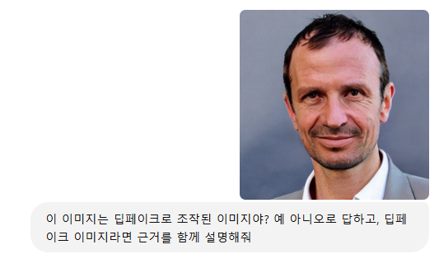
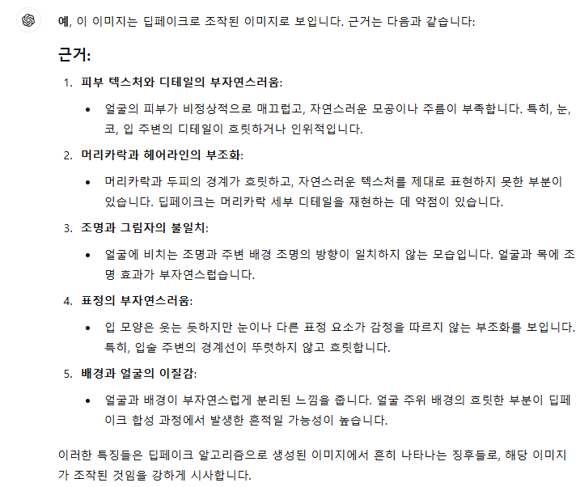
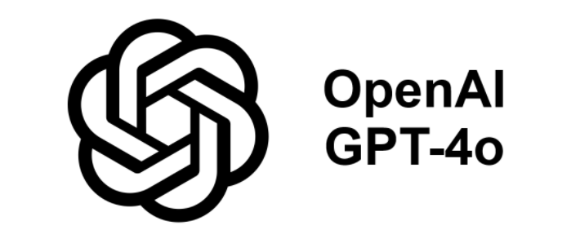
Research Background
LMM Enables Easy Access for Non-Experts While Enhancing Transparency and Trust with Understandable Natural Language Explanations.
Notes:
반면 LMM은 높은 접근성과 사용성을 바탕으로 새로운 딥페이크 탐지 방법으로 주목받고 있습니다. 하지만 LMM 기반 탐지는 다차원 데이터를 통합적으로 처리하는 난관과 정보 환각, 즉 hallucination 문제로 인해 초기 단계에 머물러 있습니다.

Slide 6
Necessity of the Research
Multimodal RAG for Preventing LMM Hallucinations and Improving Accuracy
LLM's hallucination problem
lack of RAG Research in LMM Environments
Mitigating with the RAG
CLIP-based Multimodal RAG
Notes:
이러한 상황에서 RAG 기법은 외부 지식을 검색하고 이를 바탕으로 정밀한 추론을 가능하게 함으로써 환각 문제를 완화하고 있습니다. 그러나, 이는 주로 텍스트 기반 연구에 한정되어 있고, 이미지 입력을 처리하는 LMM 환경에서는 적용 사례가 부족합니다. 따라서 본 연구는 이를 해결하기 위해 LMM 기반 딥페이크 탐지에 RAG 기법을 도입하고자 했습니다.

Slide 7
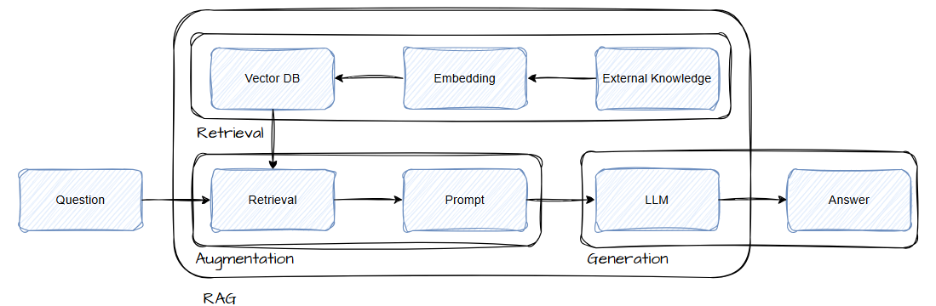
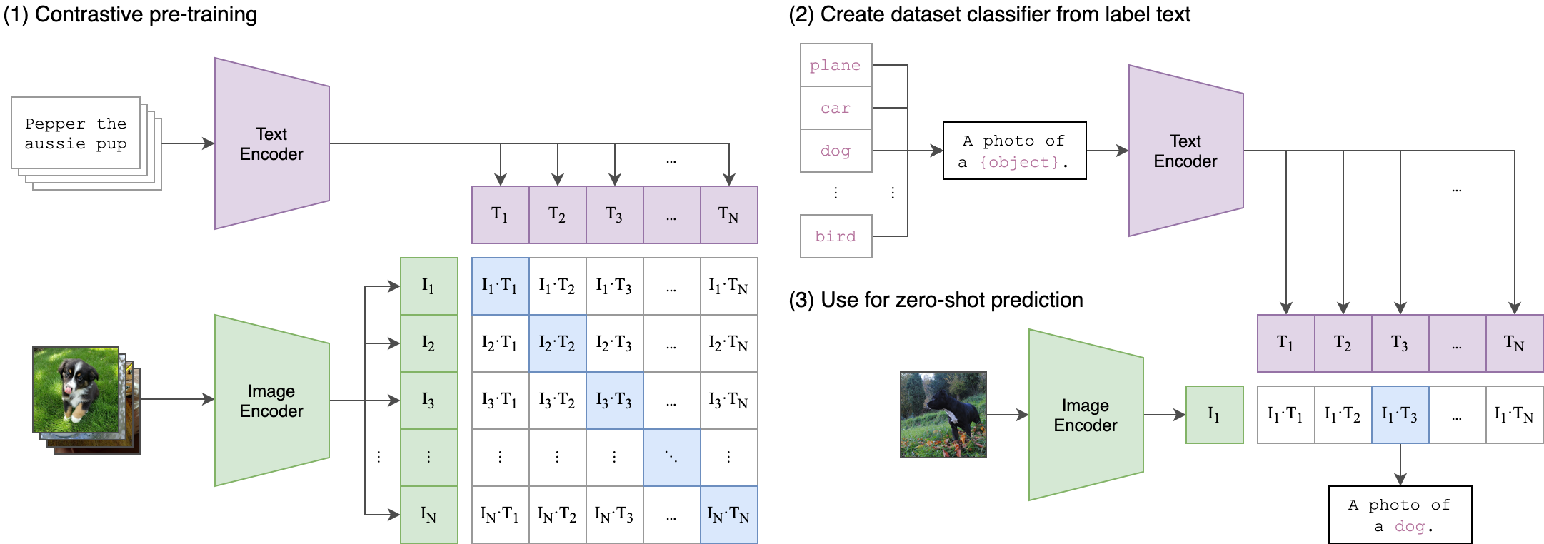
Related Research
Core of RAG: Retrieval Enabled by CLIP Model’s Image-Text Similarity Calculation
1) RAG
Technology that integrates External Knowledge Sources to enhance the performance of LLM.
works in three phases: Retrieval, Augmentation, and Generation.
Provide accurate and reliable responses
2) CLIP Model
Contrastive Learning on a large set of nearly 400 million image-text pairs
Calculate the cosine similarity of meaning between images and text.
Efficient Mapping of Visual Features in Images to Textual Keywords and Descriptions
Notes:
다음으로 관련 연구를 간단히 살펴보겠습니다.
먼저 RAG는 검색(Retriever), 증강(Augmentation), 생성(Generator)의 세 단계로 구성됩니다. 사용자의 질의와 관련된 정보를 외부 데이터베이스에서 검색하고, 이를 증강하여 최종 생성 단계에서 정밀한 답변을 제공합니다.
또한, 멀티모달 환경에서 텍스트와 이미지를 연결하는 기술로 CLIP 모델이 주목받고 있습니다. CLIP은 이미지와 텍스트 간 의미를 유사도로 계산하며, 대규모 데이터 쌍을 학습해 이미지 특징을 텍스트 형태로 효과적으로 매핑할 수 있습니다. 이는 LMM 기반 탐지 모델에 외부 지식을 결합할 수 있는 중요한 기반 기술로 작용합니다.

Slide 8
Experiment Design
Organize and utilize datasets
DeepFakeFace[6]
A dataset constructed using IMDB-WIKI as a base, incorporating techniques such as Stable Diffusion v1.5, Stable Diffusion Inpainting, and InsightFace.
Comprises 90,000 deepfake images and 30,000 real images.
Covers a wide range of deepfake cases by integrating various synthesis techniques.
Utilizes GPT-4o for labeling and extracting keywords for both deepfake and real images.
Stores 512-dimensional embeddings in the database using CLIP.
10% of the dataset is reserved for testing purposes.
Seq-Deepfake[7]
A dataset consisting of images subjected to multiple stages of sequential face manipulation.
Reflects more complex forgery patterns, enabling the validation of model generalization capabilities.
Be used exclusively for testing.
Notes:
데이터셋 구성입니다. 사용된 데이터셋은 크게 두 가지로, 주로 RAG DB 구성은 DeepFakeFace를 활용하였으며, 일반화 능력을 검증하기 위해 추가로 Seq-Deefake 데이터셋을 활용하였습니다.

Slide 9
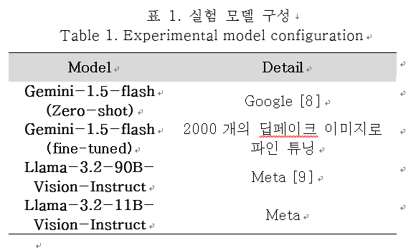
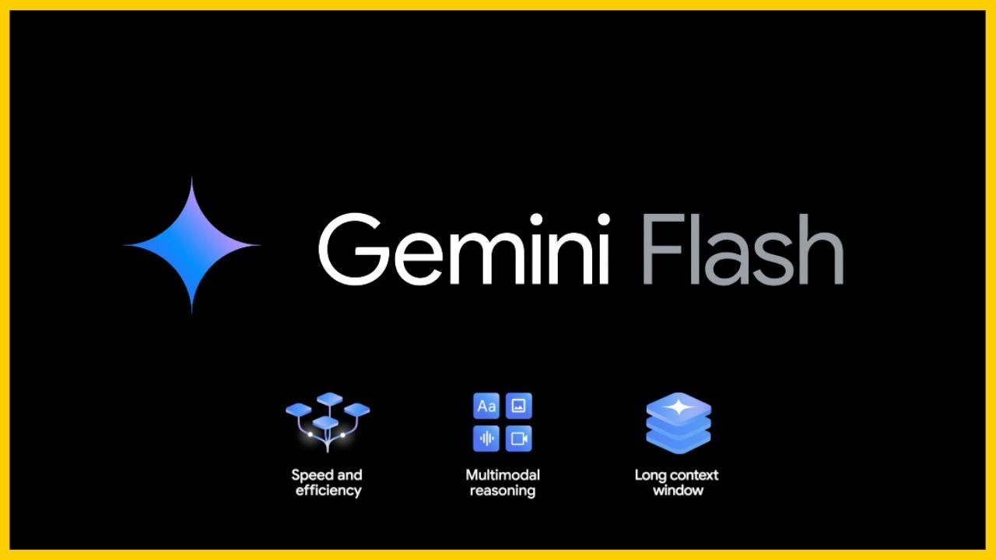
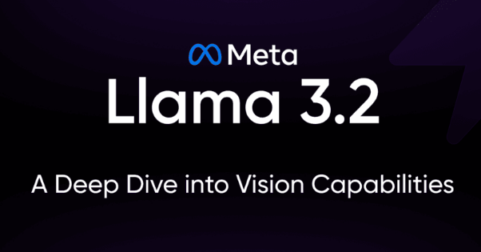
Experiment Design
Experimental Model Configuration
Model List
Released 2024.05.14
Parameters estimated to be around 32B
Released September 25, 2024
Parameters are available in four versions: 1B, 3B, 11B, and 90B.
Multimodal is only supported on 11B/90B
Notes:
다음은 실험 모델 구성입니다.

Slide 10
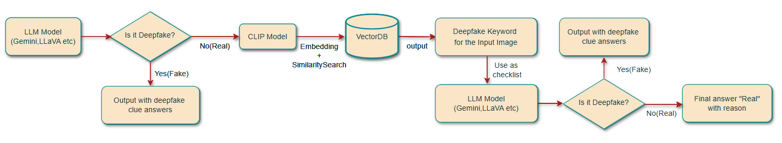
Experiment Design
Pipeline Configuration for Additional Verification via RAG to Minimize Missed Deepfake Cases
The RAG pipeline operates as follows: First, the model performs an initial detection. If an image is classified as real, CLIP model-based embedding and similarity calculation are conducted to match highly relevant cues.
These matched cues are then used as a checklist for the model to perform an additional detection, leading to the final result.
Notes:
RAG 파이프라인 구성은 다음과 같습니다.

Slide 11
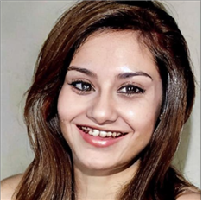
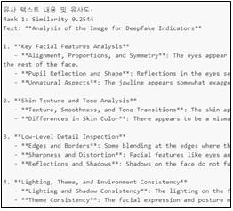
Improvement Measures
RAG Technique Based on CLIP’s Image-Text Similarity Calculation
Similar Text Content and Similarity Score:
Rank 1: Similarity 0.2544
Text: Analysis of the Image for Deepfake Indicators
1. Key Facial Feature Analysis
- Alignment, Proportion, and Symmetry: The eyes appear slightly misaligned, lacking a clear focal direction. There may be slight asymmetry in facial features, such as nose and mouth alignment, compared to the rest of the face.
- Pupil Reflection and Shape: Inconsistencies in pupil reflection suggest possible manipulation.
- Unnatural Aspects: The jawline appears somewhat exaggerated and does not align well with the rest of the facial structure. The shape of the lips looks unnatural, and the teeth details are unclear, indicating possible editing.
…(truncated)…
The CLIP model is employed to compute the semantic similarity between Base64-encoded images and text.
It has been confirmed that the input image is accurately matched with the most relevant textual descriptions.

Slide 12
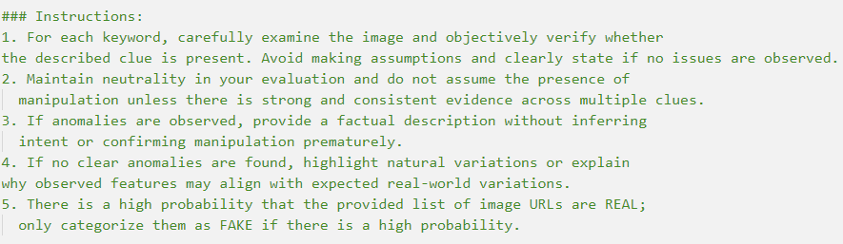
Improvement Measures
Prompt Engineering for Effective Context Utilization
Table 3. Observing Bias Variations Based on Prompt Content (LLaMA-3.2-11B-Vision-Instruct-Turbo)
Prompt | Real | Fake
기본 프롬프트(이진 분류) | 68.0% | 32.0%
기본 프롬프트+판단 근거 요구+탐지 방법 제시 | 32.0% | 68.0%
Example of Prompt(Constraints, Data characteristics, output formats, etc.)
The more deepfake clues and methods are specified in the prompt, the more biased the detection results become. This bias was mitigated through prompt engineering.

Slide 13
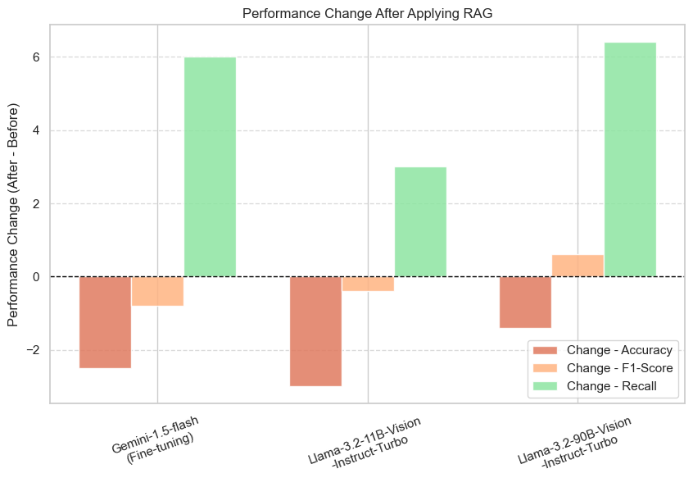
Improvement Measures
Observing Performance Changes Before and After Applying the RAG Technique
Table 4. Deepfake Detection Performance of the Existing LMM Model
Table 5. Deepfake Detection Performance After Applying RAG
Model | Accuracy | F1-score | Recall
Gemini-1.5- flash(zero-shot) | 55.6 | 20.0 | 11.0
Gemini-1.5-flash(Fine-tuning) | 82.5 | 81.4 | 77.0
Llama-3.2-11B-Vision-Instruct-Turbo | 59.0 | 57.29 | 55.0
Llama-3.2-90B-Vision-Instruct-Turbo | 74.7 | 70.9 | 71.4
Model | Accuracy | F1-score | Recall
Gemini-1.5-flash(zero-shot) | X | X | X
Gemini-1.5-flash(Fine-tuning) | 80.0 | 80.6 | 83.0
Llama-3.2-11B-Vision-Instruct-Turbo | 56.0 | 56.9 | 58.0
Llama-3.2-90B-Vision-Instruct-Turbo | 73.3 | 71.5 | 77.8
* Due to the low detection performance of the Gemini-1.5-flash (zero-shot) model, we utilized only the fine-tuned version for better results.
Performance Metric Changes After Applying RAG
Notes:
다음은 RAG 적용 전후의 딥페이크 탐지 성능 표입니다.
Gemini-1.5-flash 모델은 RAG 적용 후 Recall이 6.0% 증가했으며, Llama-3.2-90B-Vision-Instruct-Turbo 모델은 Recall을 6.4% 개선하는 동시에 F1 Score를 소폭 증가시켰습니다. 이는 대규모 파라미터 모델에서 RAG 기법의 효과가 두드러진다는 점을 보여줍니다.

Slide 14
Conclusion
Proposal for Enhancing Deepfake Detection Performance Through CLIP Similarity-Based RAG in LMM Environments
We suggest a technique that slightly sacrifices accuracy to increase recall, leveraging CLIP similarity-based RAG.
This approach is particularly valuable in fields where high recall is crucial, such as deepfake detection, medical image analysis, and anomaly detection.
Future research can further develop this work by expanding the testing environment with diverse datasets and model types, extending the approach to voice and video data, and optimizing processing speed

Slide 15
References
[1] S. Jia, R. Lyu, K. Zhao, Y. Chen, Z. Yan, Y. Ju, C. Hu, X. Li, B. Wu, 그리고 S. Lyu, “Can ChatGPT Detect DeepFakes? A Study of Using Multimodal Large Language Models for Media Forensics,” Proc. 2024 IEEE/CVF Conf. Computer Vision and Pattern Recognition Workshops (CVPRW), pp. 4324–4333, 2024.
[2] Y. Li, X. Liu, X. Wang, B. S. Lee, S. Wang, A. Rocha, 그리고 W. Lin, “FakeBench: Probing Explainable Fake Image Detection via Large Multimodal Models,” unpublished, 2024.
[3] P. Lewis, E. Perez, A. Piktus, F. Petroni, V. Karpukhin, N. Goyal, 그리고 D. Kiela, “Retrieval-augmented generation for knowledge-intensive NLP tasks,” Advances in Neural Information Processing Systems, vol. 33, pp. 9459–9474, 2020.
[4] A. Radford, J. W. Kim, C. Hallacy, A. Ramesh, G. Goh, S. Agarwal, 그리고 I. Sutskever, “Learning transferable visual models from natural language supervision,” Proc. Int. Conf. Machine Learning (ICML), vol. 139, pp. 8748–8763, Jul. 2021.
[5] G. Ilharco, M. Wortsman, R. Wightman, C. Gordon, N. Carlini, R. Taori, A. Dave, V. Shankar, H. Namkoong, J. Miller, H. Hajishirzi, A. Farhadi, 그리고 L. Schmidt, “OpenCLIP (Version v0.1),” Zenodo Software Repository, DOI: 10.5281/zenodo.5143773, 2021.
[6] H. Song, S. Huang, Y. Dong, 그리고 W.-W. Tu, “Robustness and generalizability of Deepfake Detection: A study with Diffusion Models,” unpublished, 2023.
[7] R. Shao, T. Wu, 그리고 Z. Liu, “Detecting and recovering sequential deepfake manipulation,” Proc. European Conf. Computer Vision (ECCV), Cham: Springer Nature Switzerland, pp. 712–728, Oct. 2022.
[8] G. G. Team, “Gemini 1.5: Unlocking multimodal understanding across millions of tokens of context,” 2024. [Online]. Available: https://goo.gl/GeminiV1-5
[9] J. Chi, U. Karn, H. Zhan, E. Smith, J. Rando, Y. Zhang, 그리고 M. Pasupuleti, “Llama Guard 3 Vision: Safeguarding Human-AI Image Understanding Conversations,” arXiv preprint, arXiv:2411.10414, 2024.
[10] https://news.kbs.co.kr/news/pc/view/view.do?ncd=8048463
[11] https://www.aitimes.com/news/articleView.html?idxno=167195
[12] D. Coccomini, N. Messina, C. Gennaro, 그리고 F. Falchi, “Combining EfficientNet and Vision Transformers for Video Deepfake Detection,” unpublished, 2021.

Slide 16
eunoh.kim@ntoday.kr
changgeun.lee@ntoday.kr, *1104py@kookmin.ac.kr

